Slide 1
Great ideas and Practices

Slide 2
Tag Team of
John Bisset CPB, KD4LJD
and
Mark Persons CPBE, CBNT, AMD, WØMH

Slide 3
Another Format Change and the Angry Listener

Slide 4
Site Security is Important
Locks
Alarm Systems
Redundancy
Make A Friend
with
Law Enforcement

Slide 5
Organize and Identify All Keys

Slide 6
A Flashlight at the Entry Door

Slide 7
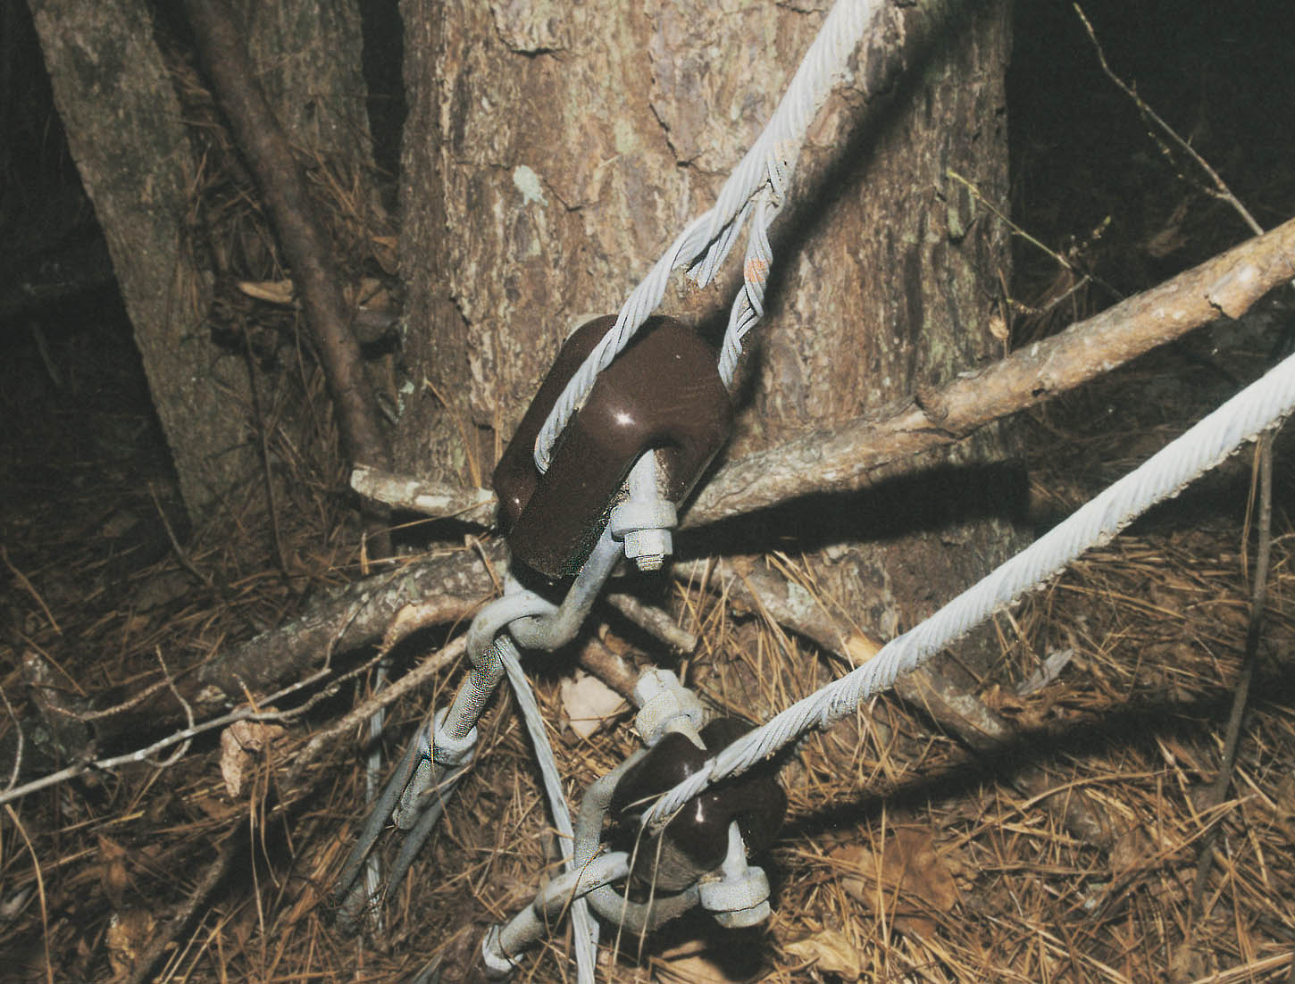
Walk Your Site at Least Quarterly

Slide 8
What transmitter Site?

Slide 9
Adding Camera Security
Inexpensive camera system monitors your sites

Slide 10
Web Cam Diagnosis

Slide 11
What’s in Your Tool Box?
Every engineer needs a
good tool box

Slide 13
Never leave home without plenty of parts and hex wrenches

Slide 16
Plenty of room for tools and supplies. A steel wall to protect the driver too.

Slide 17
A sliding side door is better than swinging doors in a garage. Six-drawer parts bins with dividers are terrific. Lots of parts in boxes on the shelves too. Aluminum bar stock holds tool box.

Slide 18
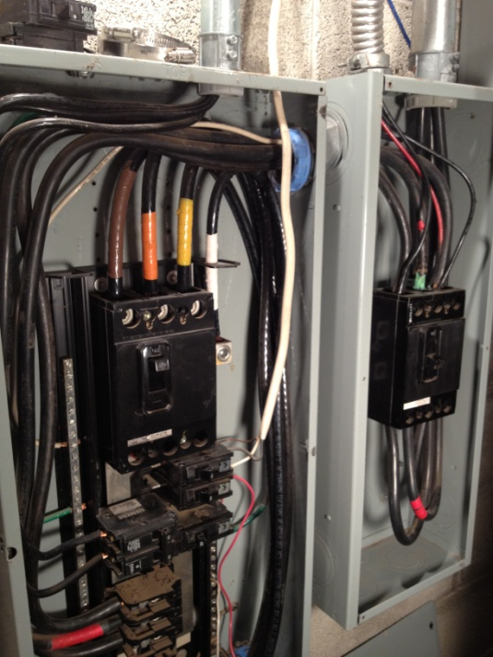
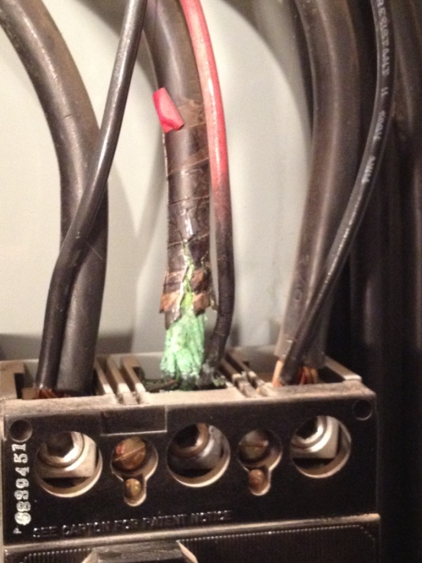
Tighten electrical connections yearly

Slide 19
Better Yet, View Connection Temperatures
Fluke IR Thermometer - $99
RF Connections
Electrical breaker boxes
AM Phasors and ATU components
Any connection that gets loose
and generates heat

Slide 20
Rigid Coaxial Thermal Imaging

Slide 21
Orange is the hottest

Slide 22
A Fluke Volt-Pen could save your life

Slide 23
Proper Grounding Limits Lightning Damage

Slide 24
Old transmitters make great backups

Slide 25
Hollow-state electronics

Slide 26
An oscilloscope…your “best” AM Modulation Monitor

Slide 27
RF Exposure!!

Slide 28
RF Shielded

Slide 29
Enclosed AM RF Switch

Slide 30
Use Labels Liberally Watch it! No political comments allowed here!

Slide 31
A Drip Pan Catches Condensate – Cheap Insurance
Protects equipment underneath

Slide 32
Inspect Towers After Wind Storms

Slide 33
The result of Wind Shear – do you have a backup plan?

Slide 34
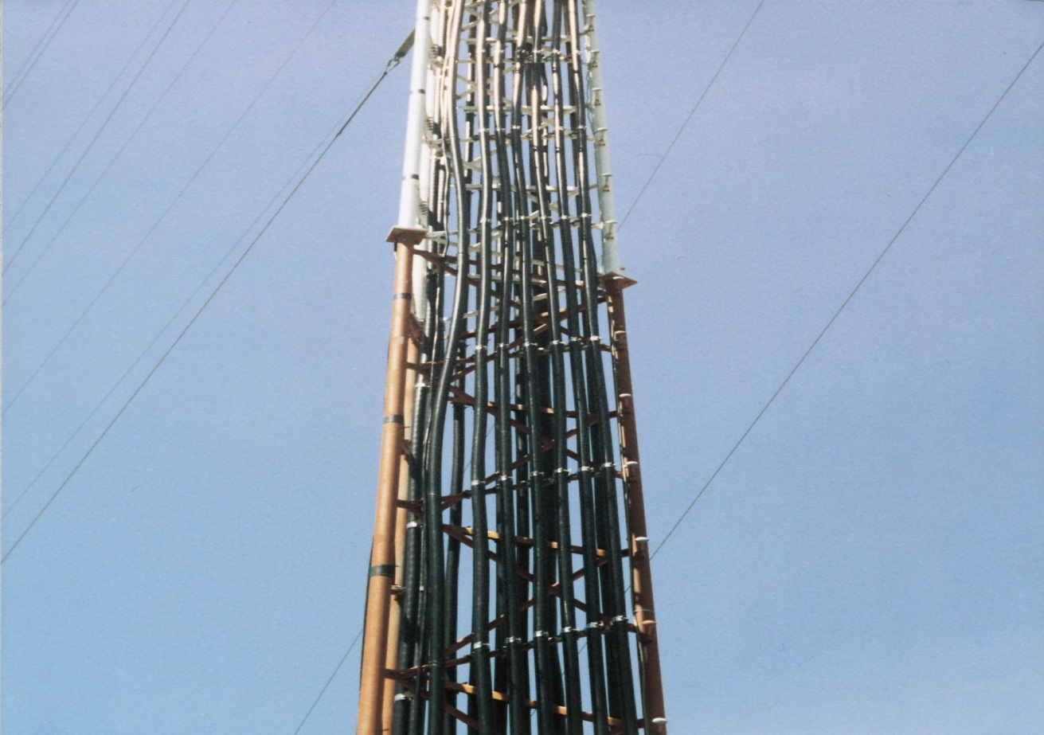
WANTED: Qualified Site Manager ALWAYS Monitor Sub contractors

Slide 35
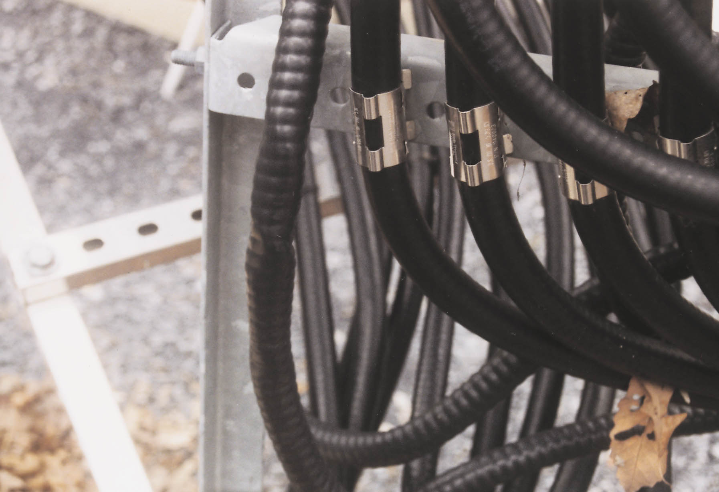
Coax Is Not a Climbing Peg!

Slide 36
Satellite Maintenance – Bee Keeper

Slide 37
A 1-Liter Water Bottle Solution Prevent Wasp Nests!

Slide 38
Be Kind To Animals

Slide 39
What’s Hiding In Your Pipe?

Slide 40
Engineering Ingenuity!

Slide 41
Keep hand written notes so you know what to bill. Forgetting to make notes means forgetting to bill. Ouch!

Slide 42
Field Reports are important. They tell the story of what you have done.

Slide 43
A Cheap Test Clip Holder

Slide 44
Another Third Hand Solution

Slide 45
Don’t Throw Away the White Board

Slide 46
More Innovation

Slide 47
www.waterbug.com
Prevent flooding with a water sensor

Slide 48
Burk Arc Detector
Blue light indicates arc
Any flame or arc is detected

Slide 49
Hall of Shame

Slide 50
120 VAC power cord going through a door along with computer wiring!

Slide 51
Your Terminal Room?

Slide 52
Satellite dish held in position by concrete blocks and phone book!

Slide 53
Hall of Shame times two!

Slide 54
John Bisset Western Regional Sales Manager of Telos Alliance http://telosalliance.com john.bisset@telosalliance.com and Mark Persons The Radio Doctor http://mwpersons.com mark@mwpersons.com

